Slide 1

Group 10
Car Loan and its Financial Management

Slide 2

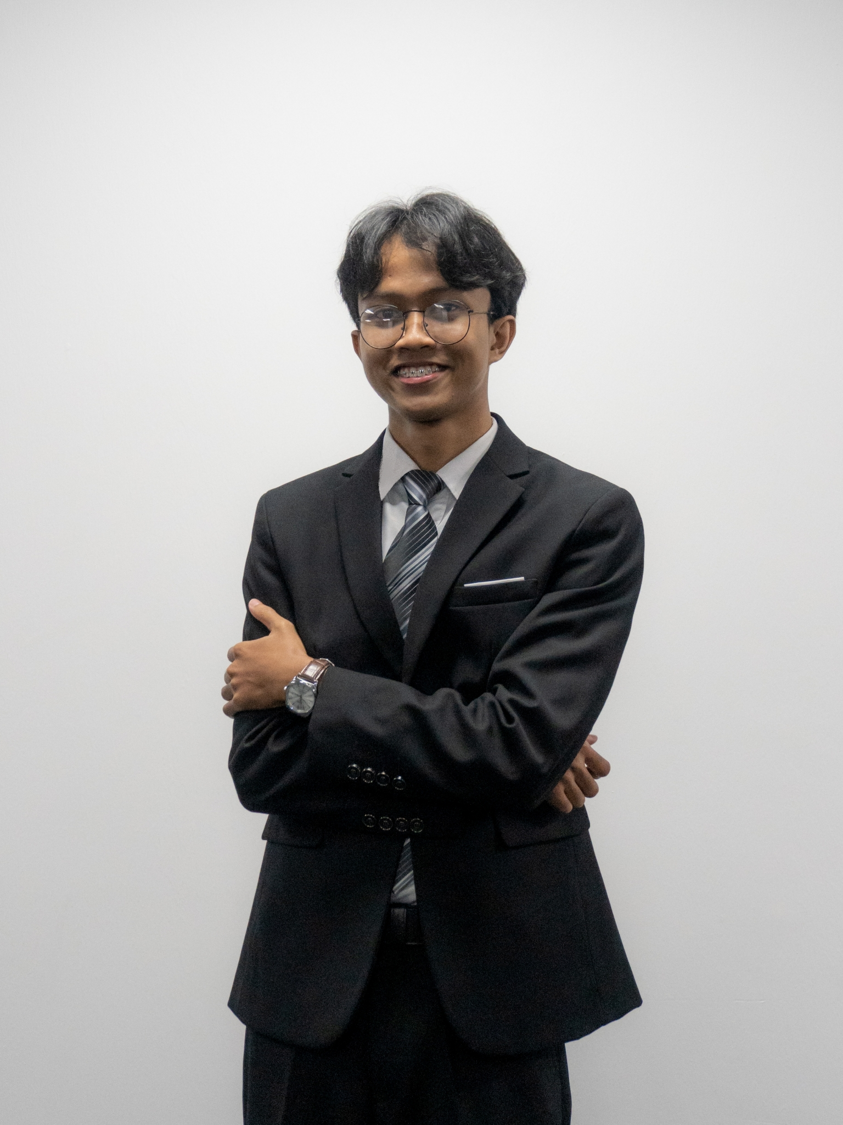
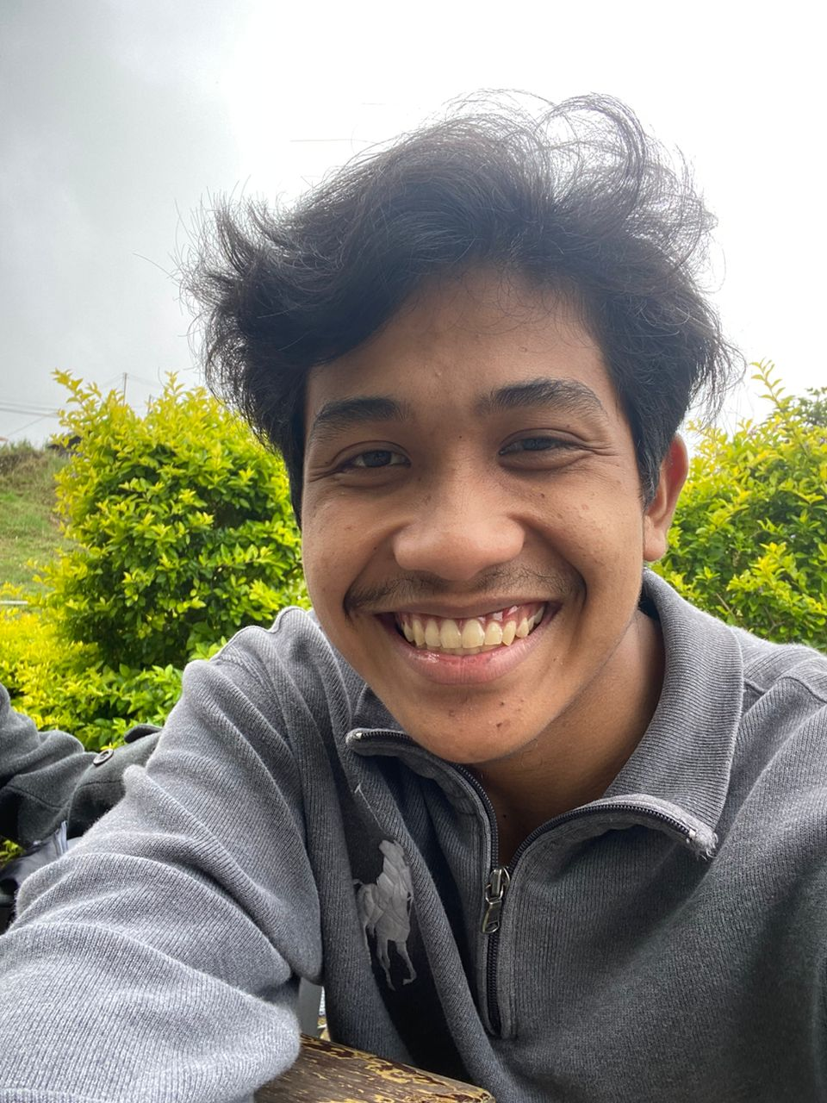
Team Members
MUHAMMAD HATIM JAMALUDIN BIN SUBKI
BSW01084696
Computing Background:
Foundation in Comp Science
Created a mobile game in high school
MOHAMMAD DANISH DANIAL BIN MOHD ROSLI
BSW01084690
Computing Background:
UI/UX Designer
Backend Developer
Solution Architecture Provider
ROZAILI MOHAMAD ALMUSHAMIL BIN CHE SUB
BSW01085254
Computing Background:
1. Early exposure of coding in school
2. Scratch and Python master
3. Foundation in Comp Science

Slide 3
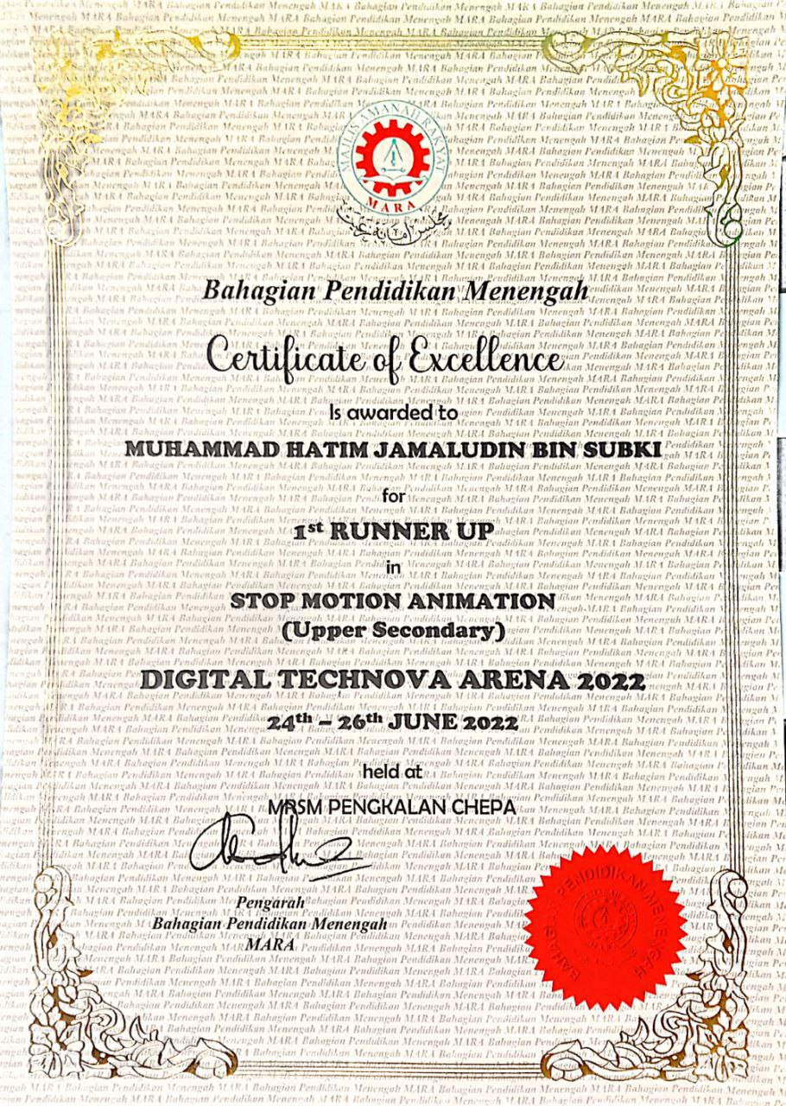
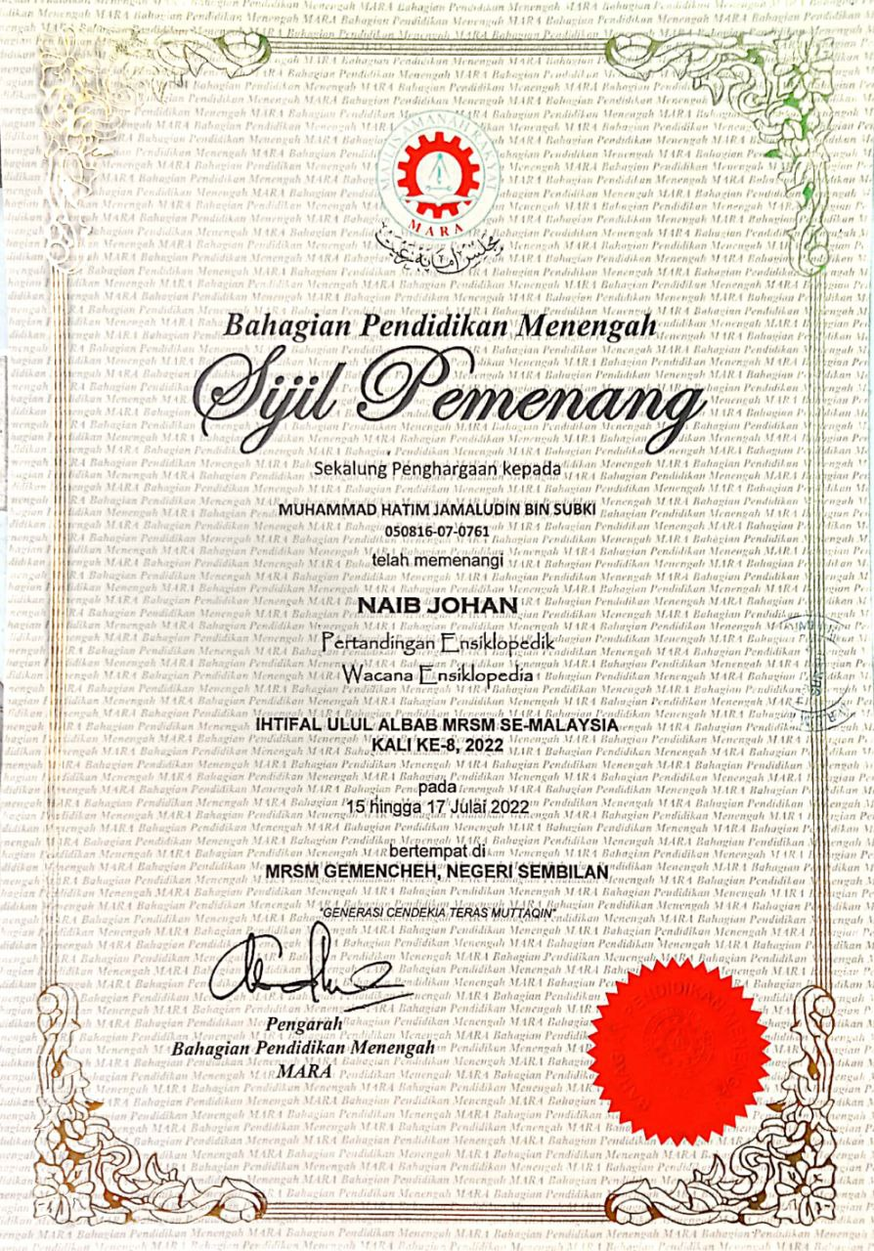
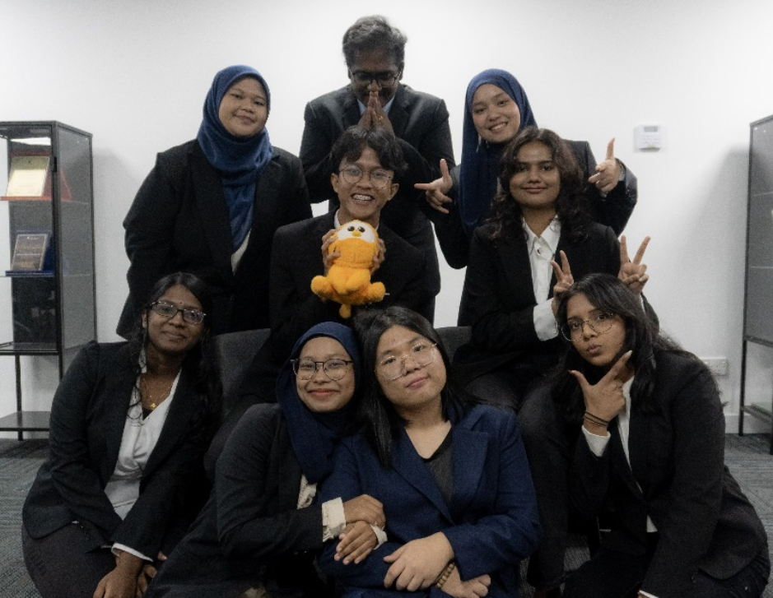
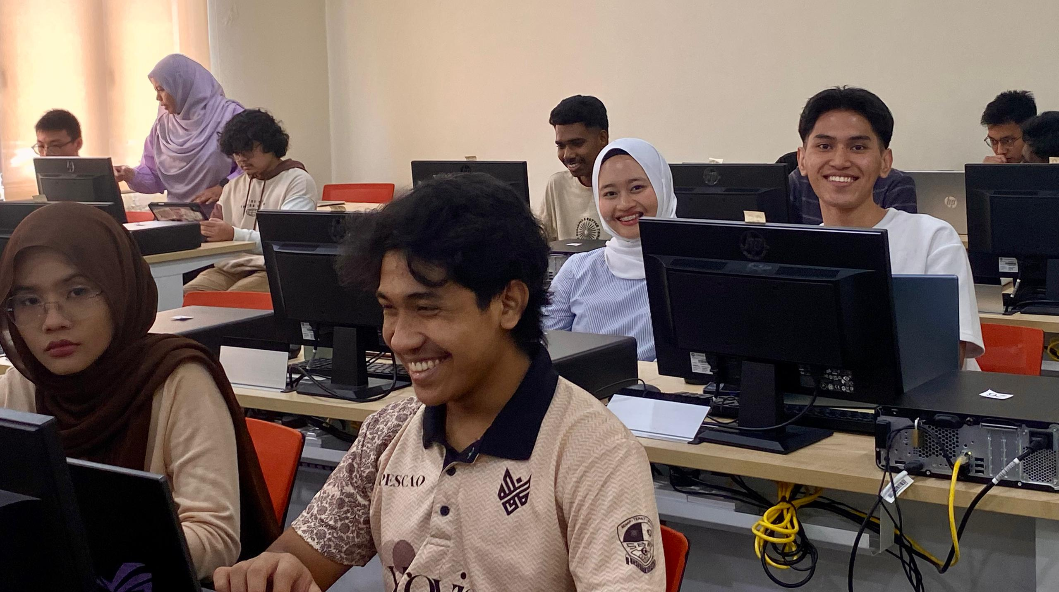
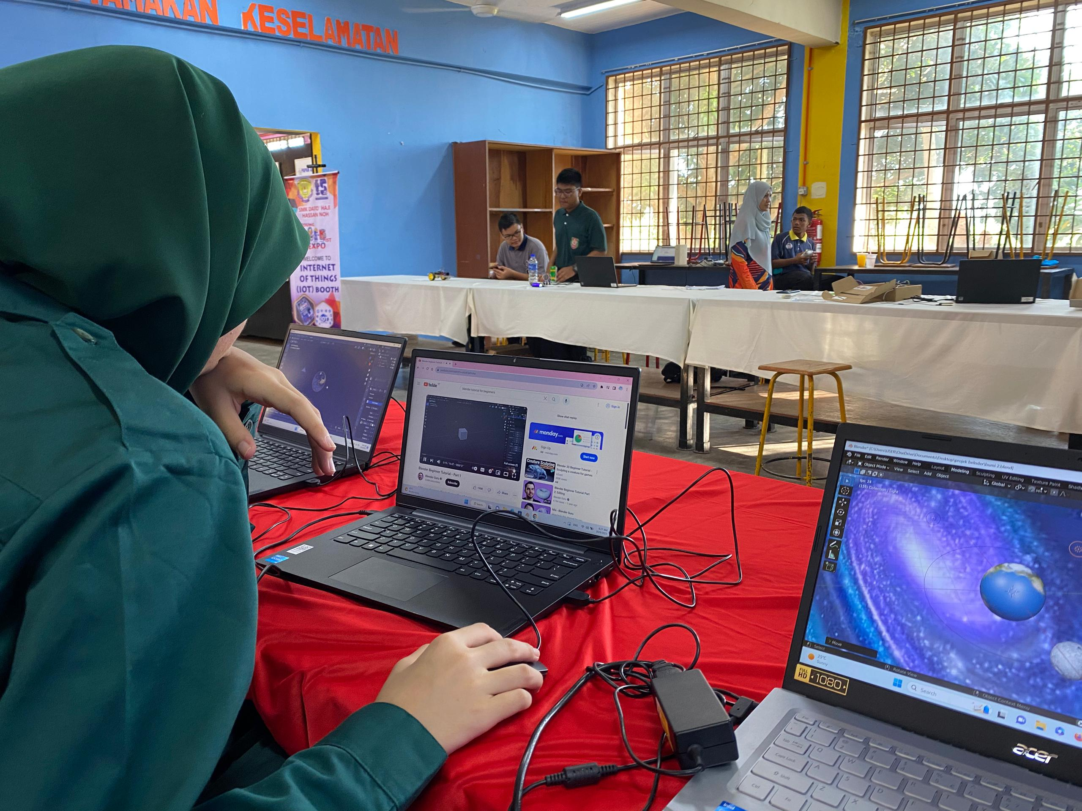
Team Visions (Interest)
Participating in Digital Technova Arena 2022 as following a trends in AI and AR development.
Contributing to team advocacy of tech awareness in future development of cutting-edge nation.
Interested in AI tool to develop innovative solutions to current issues.

Slide 4
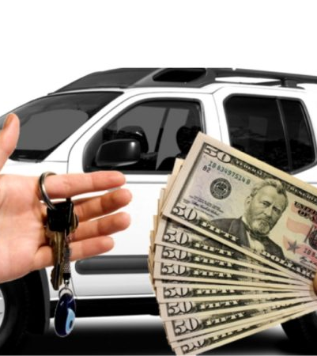
Introduction
Car loans are a vital financial tool that enable individuals to purchase vehicles by borrowing funds from financial institutions. This case study explores the dynamics of car loans, focusing on their structure, repayment mechanisms, and impacts on both lenders and borrowers. The objective is to analyze different loan packages, address common challenges, and propose solutions for effective car loan management.

Slide 5
Objectives
Understanding car loans
Provide their structure
Expose the impacts on borrowers and leaners

Slide 6
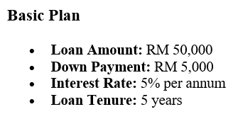
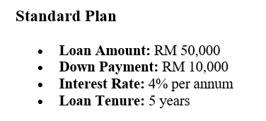
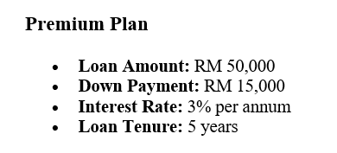
Loan Packages

Slide 7
Repayment Schedule
Year | Principal (RM) | Interest (RM) | Total Payment (RM)
1 | 10,000 | 2,500 | 12,500
2 | 10,000 | 2,000 | 12,000
3 | 10,000 | 1,500 | 11,500
... | ... | ... | ...

Slide 8


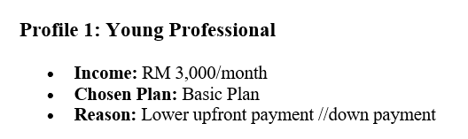
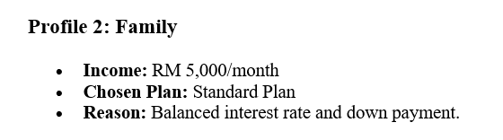
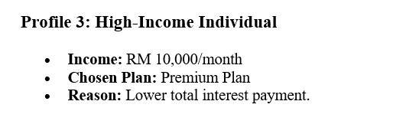
Customer Profiles

Slide 9
GitHub Collaboration
Steps taken:
Repository setup.
Adding DOCX and PPTX files thru Git.
Branch creation and pull request.
Merging pull request.

Slide 10
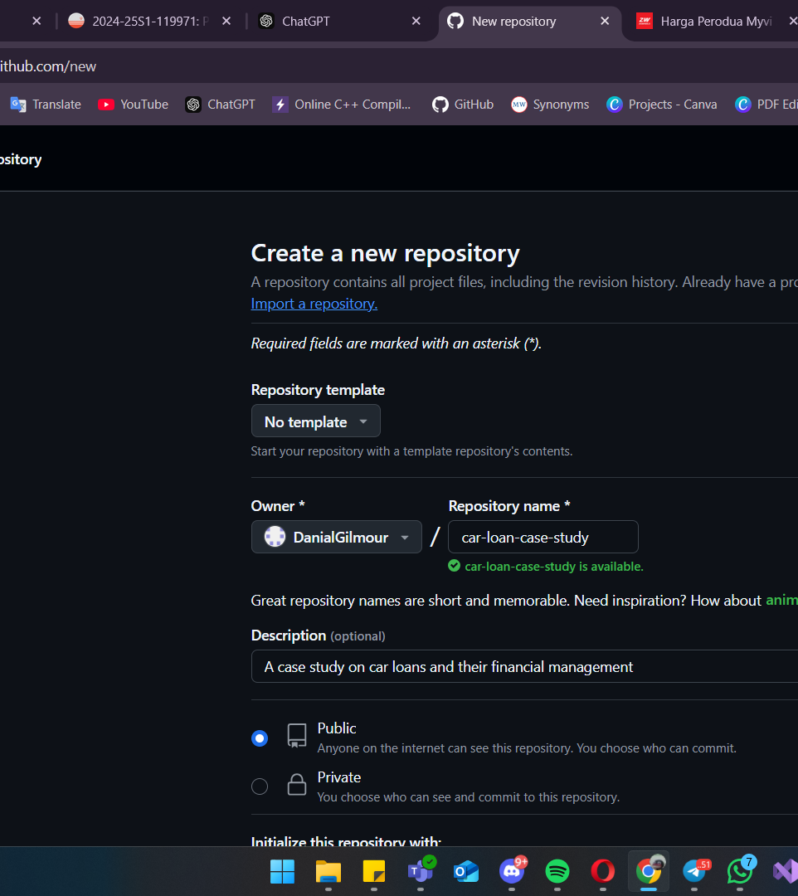
1. Creating a main repository.

Slide 11
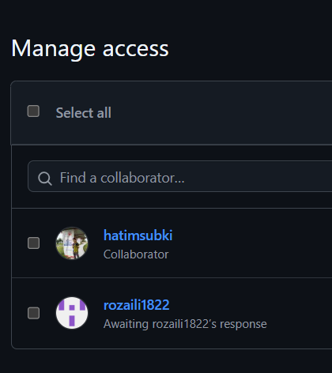
2. Set up team collaboration.

Slide 12
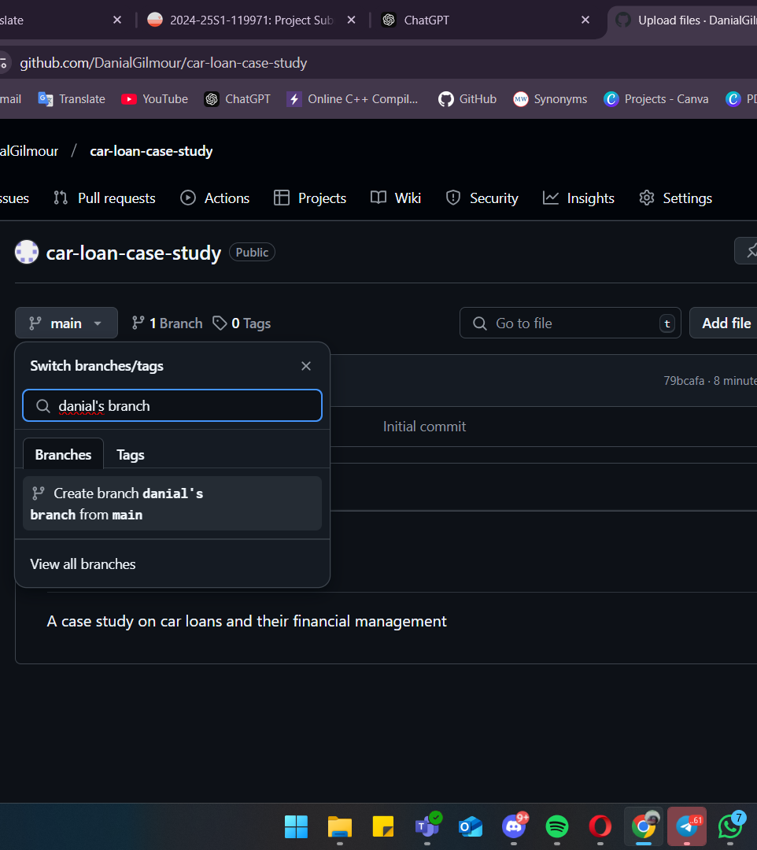
3. Creating an individual branch on GitHub. (Individual POV)

Slide 13
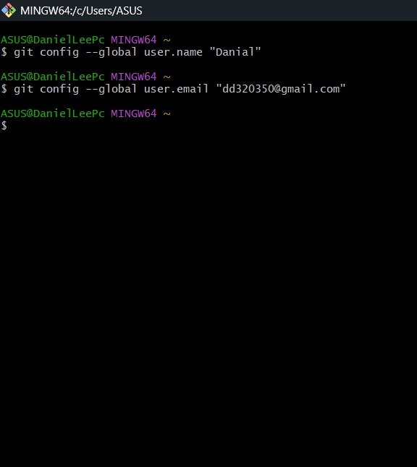
4. Configure user on Git.

Slide 14
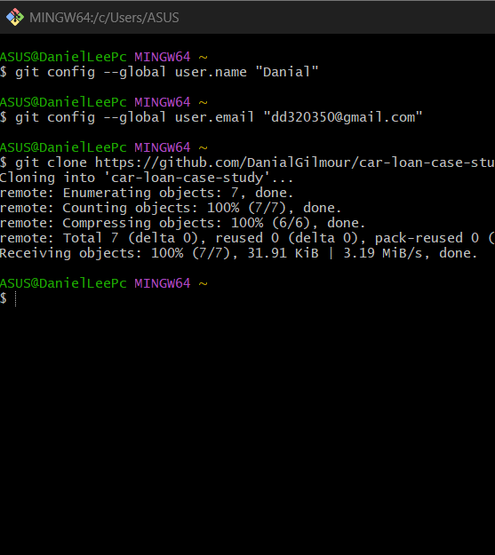
5. Cloning Repository from GitHub to Git.

Slide 15
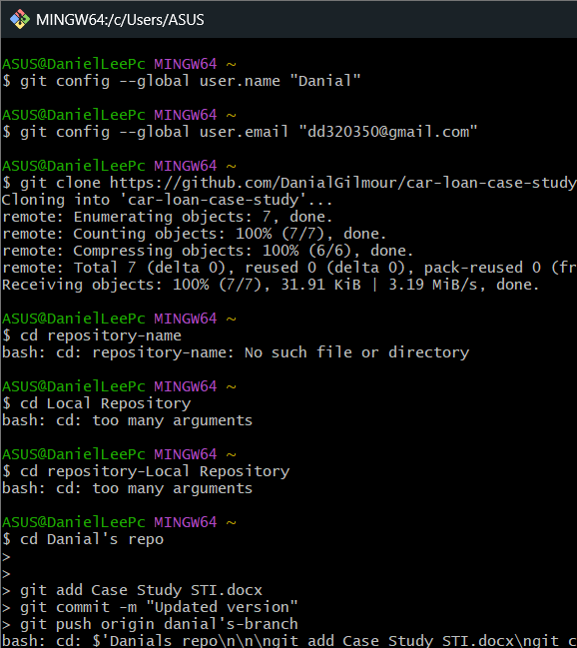
6. Prompted git add, git commit, and git pushed.
git add: upload the docx document to staging area
git commit: submit it to the local branch
git push: send the local repository to remote branch

Slide 16
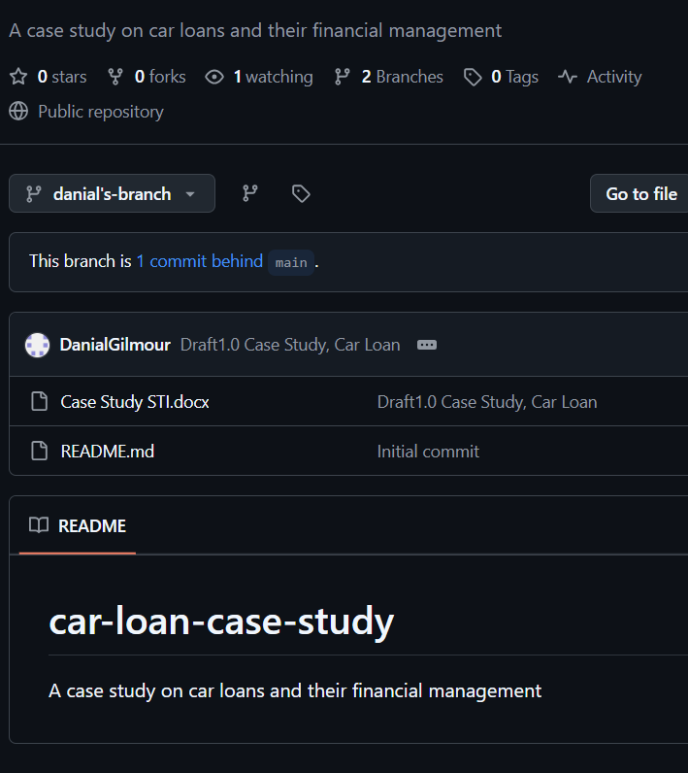
7. The changes has been made on GitHub.

Slide 17
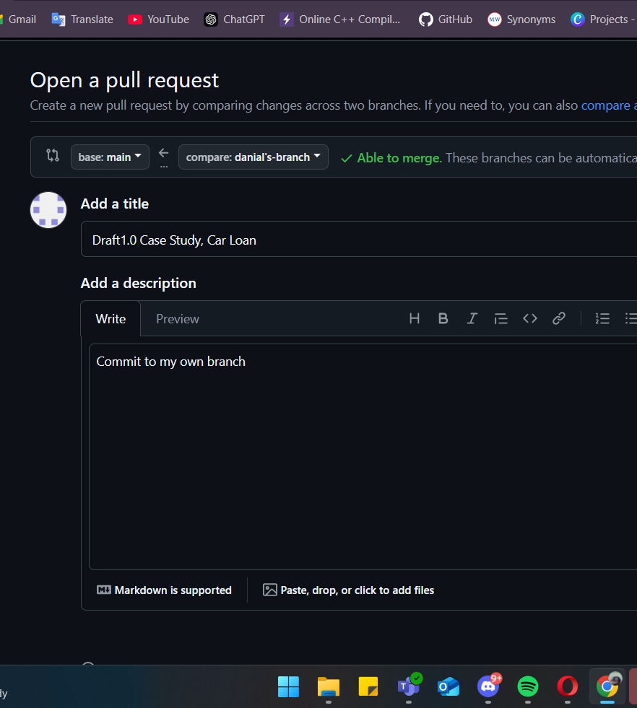
8. Pull request to allow danial’s branch to get into the main branch.

Slide 18
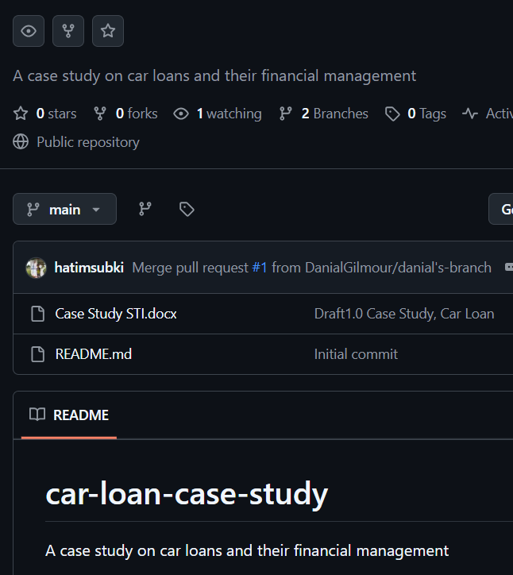
9. Merge pull request has been approved by one of the team to allow changes from danial’s branch to get into the main branch.

Slide 19
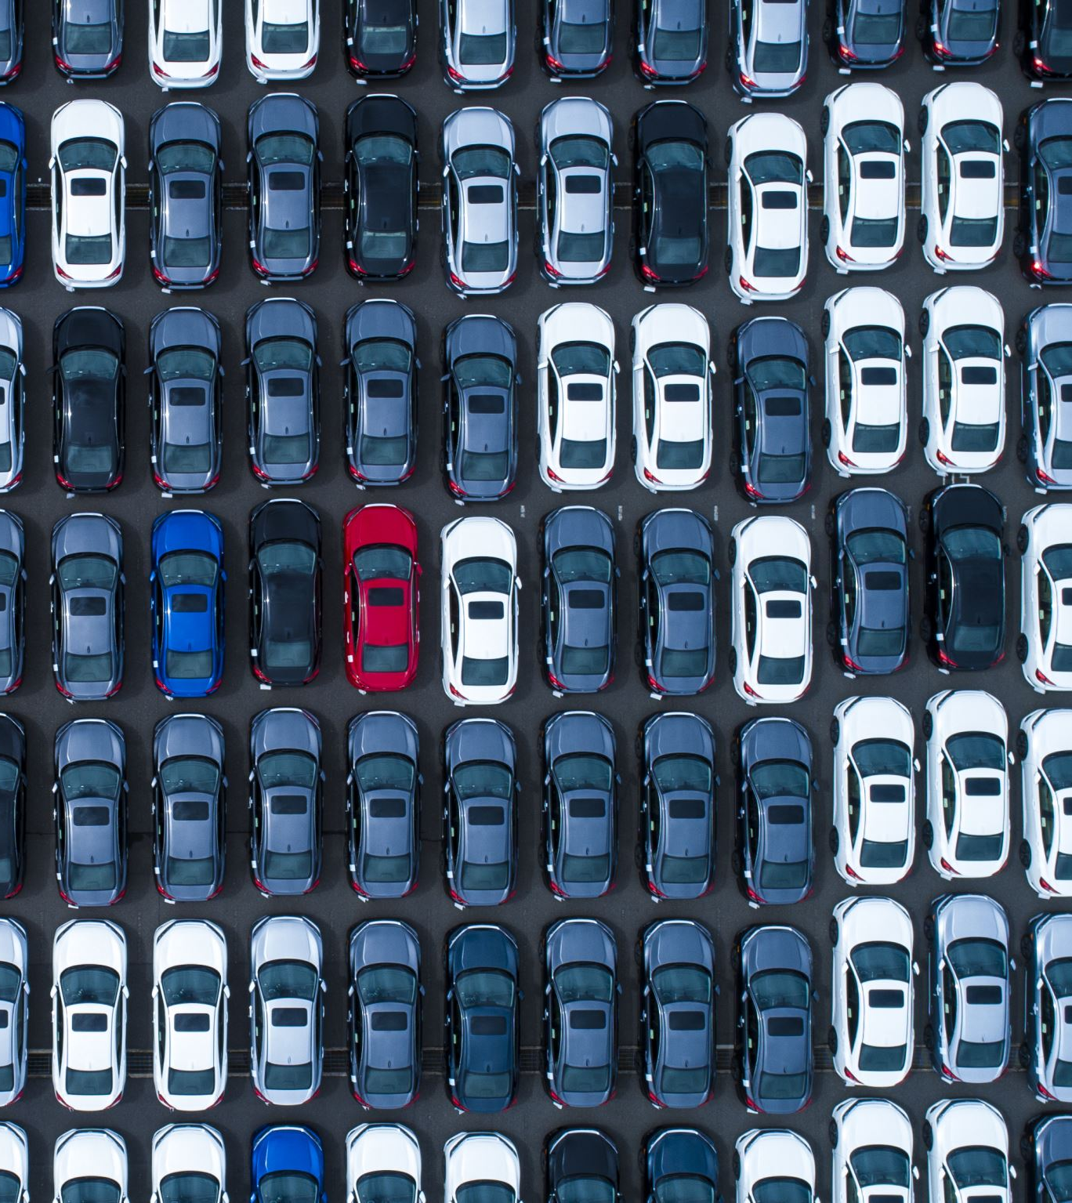
Conclusions
Car loans are essential in promoting vehicle ownership while balancing the financial capabilities of borrowers. Tailoring loan packages to different customer needs and implementing risk mitigation strategies can improve outcomes for both lenders and borrowers.

Slide 20
References
Resources:
1. Git Tutorial: https://www.w3schools.com/git/
2. Git Tutorial Video: https://www.youtube.com/watch?v=tRZGeaHPoaw
3. GitHub Tutorial: https://docs.github.com/en/get-started/start-your-journey/hello-world
GitHub: https://github.com/DanialGilmour/car-loan-case-study

Slide 21
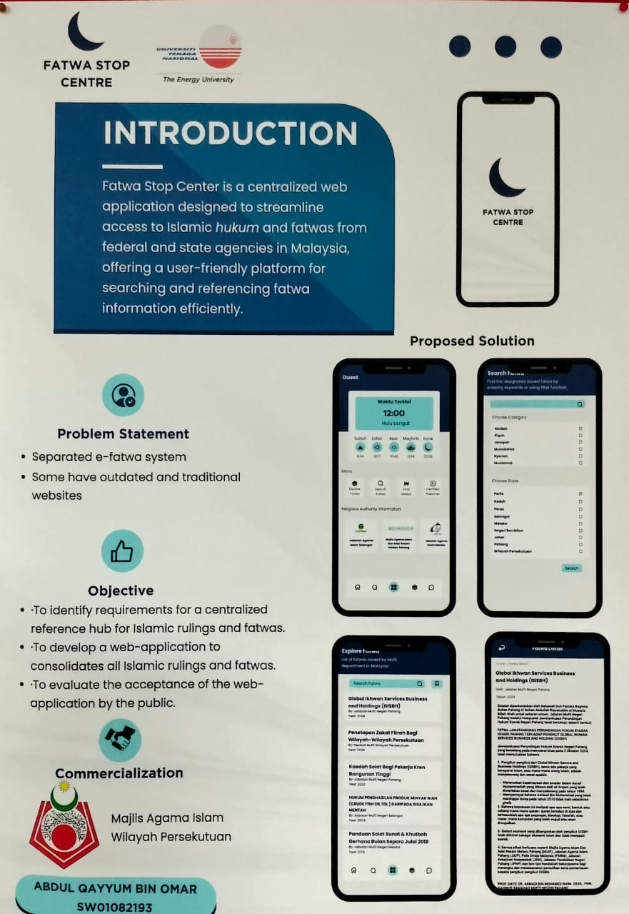
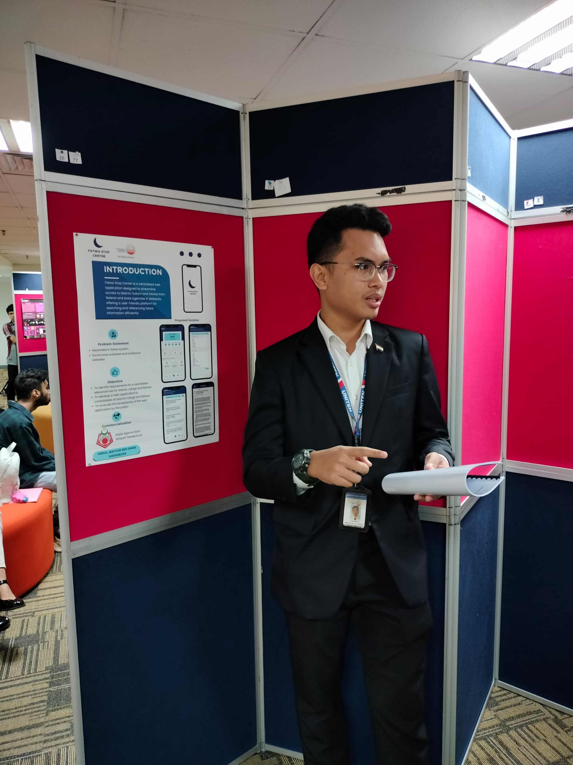
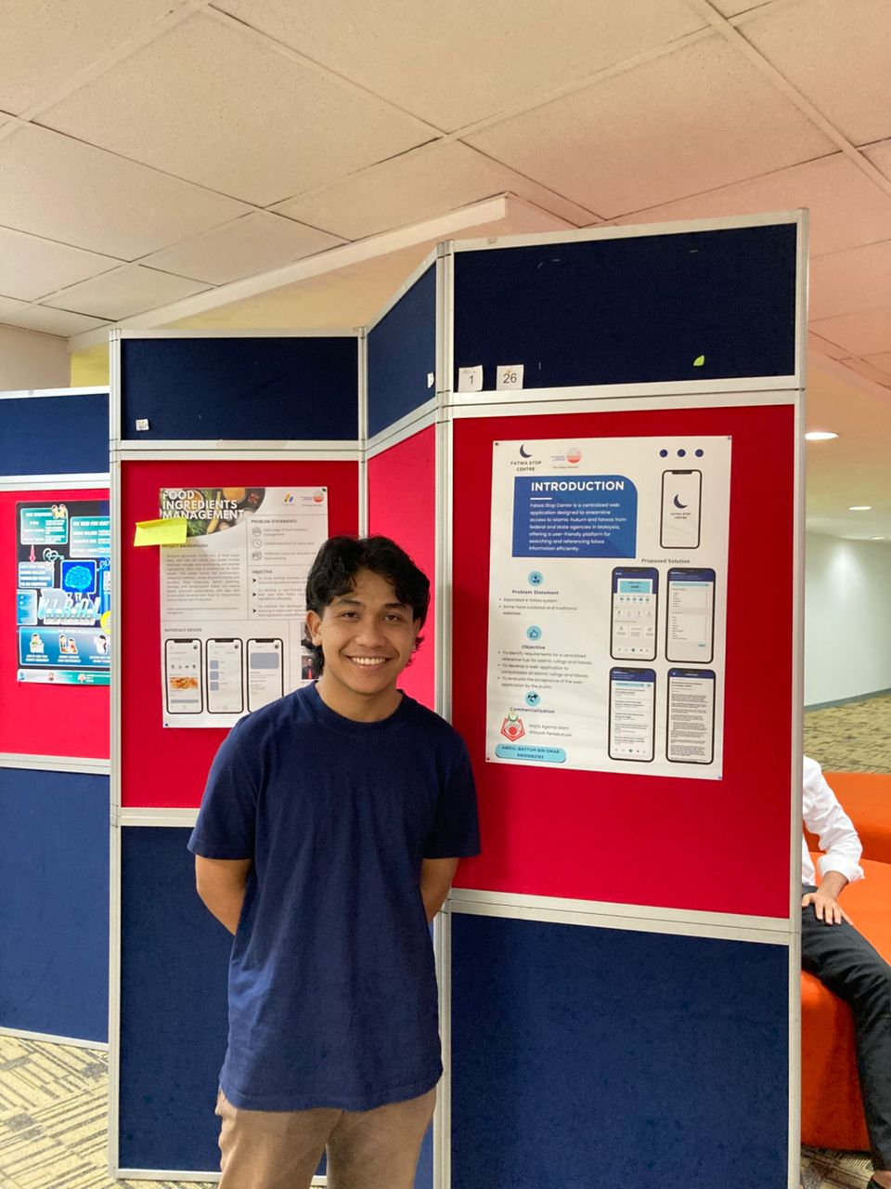
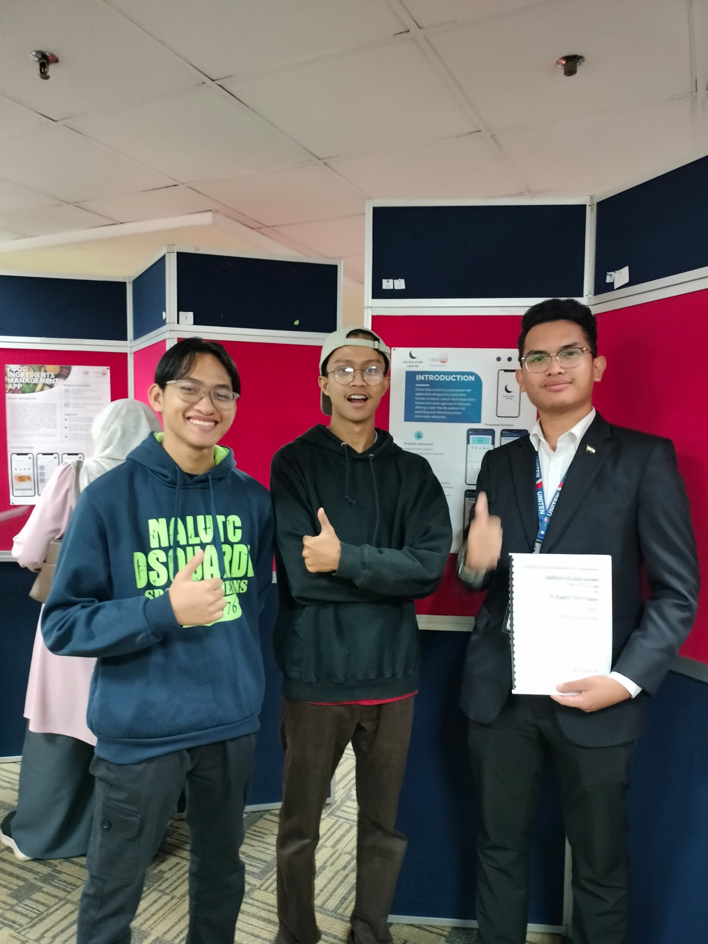
Summary of 5 Best Final Year Project 1
Fatwa Stop Centre
Project Name : Fatwa Stop Center
Presented By : Abdul Qayyum Bin Omar
Summary of The Project : A centralized web application called the Fatwa Stop Center makes it easier to get Islamic Hukum and Fatwa from Malaysian federal and state authorities.
Reason For Choosing : Offering a single, intuitive platform for effective searching and reference, it solved fragmented systems and out-to-dates webpages

Slide 22
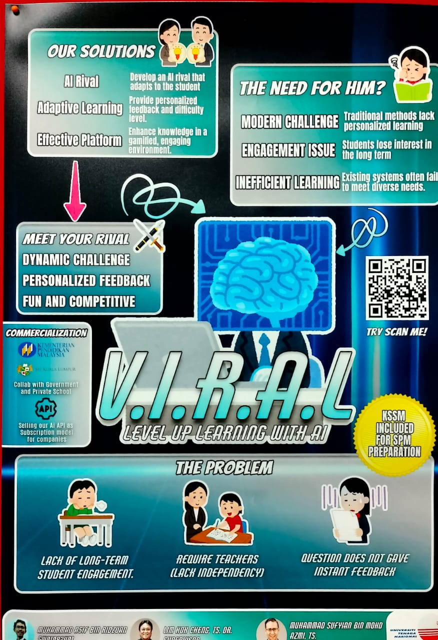
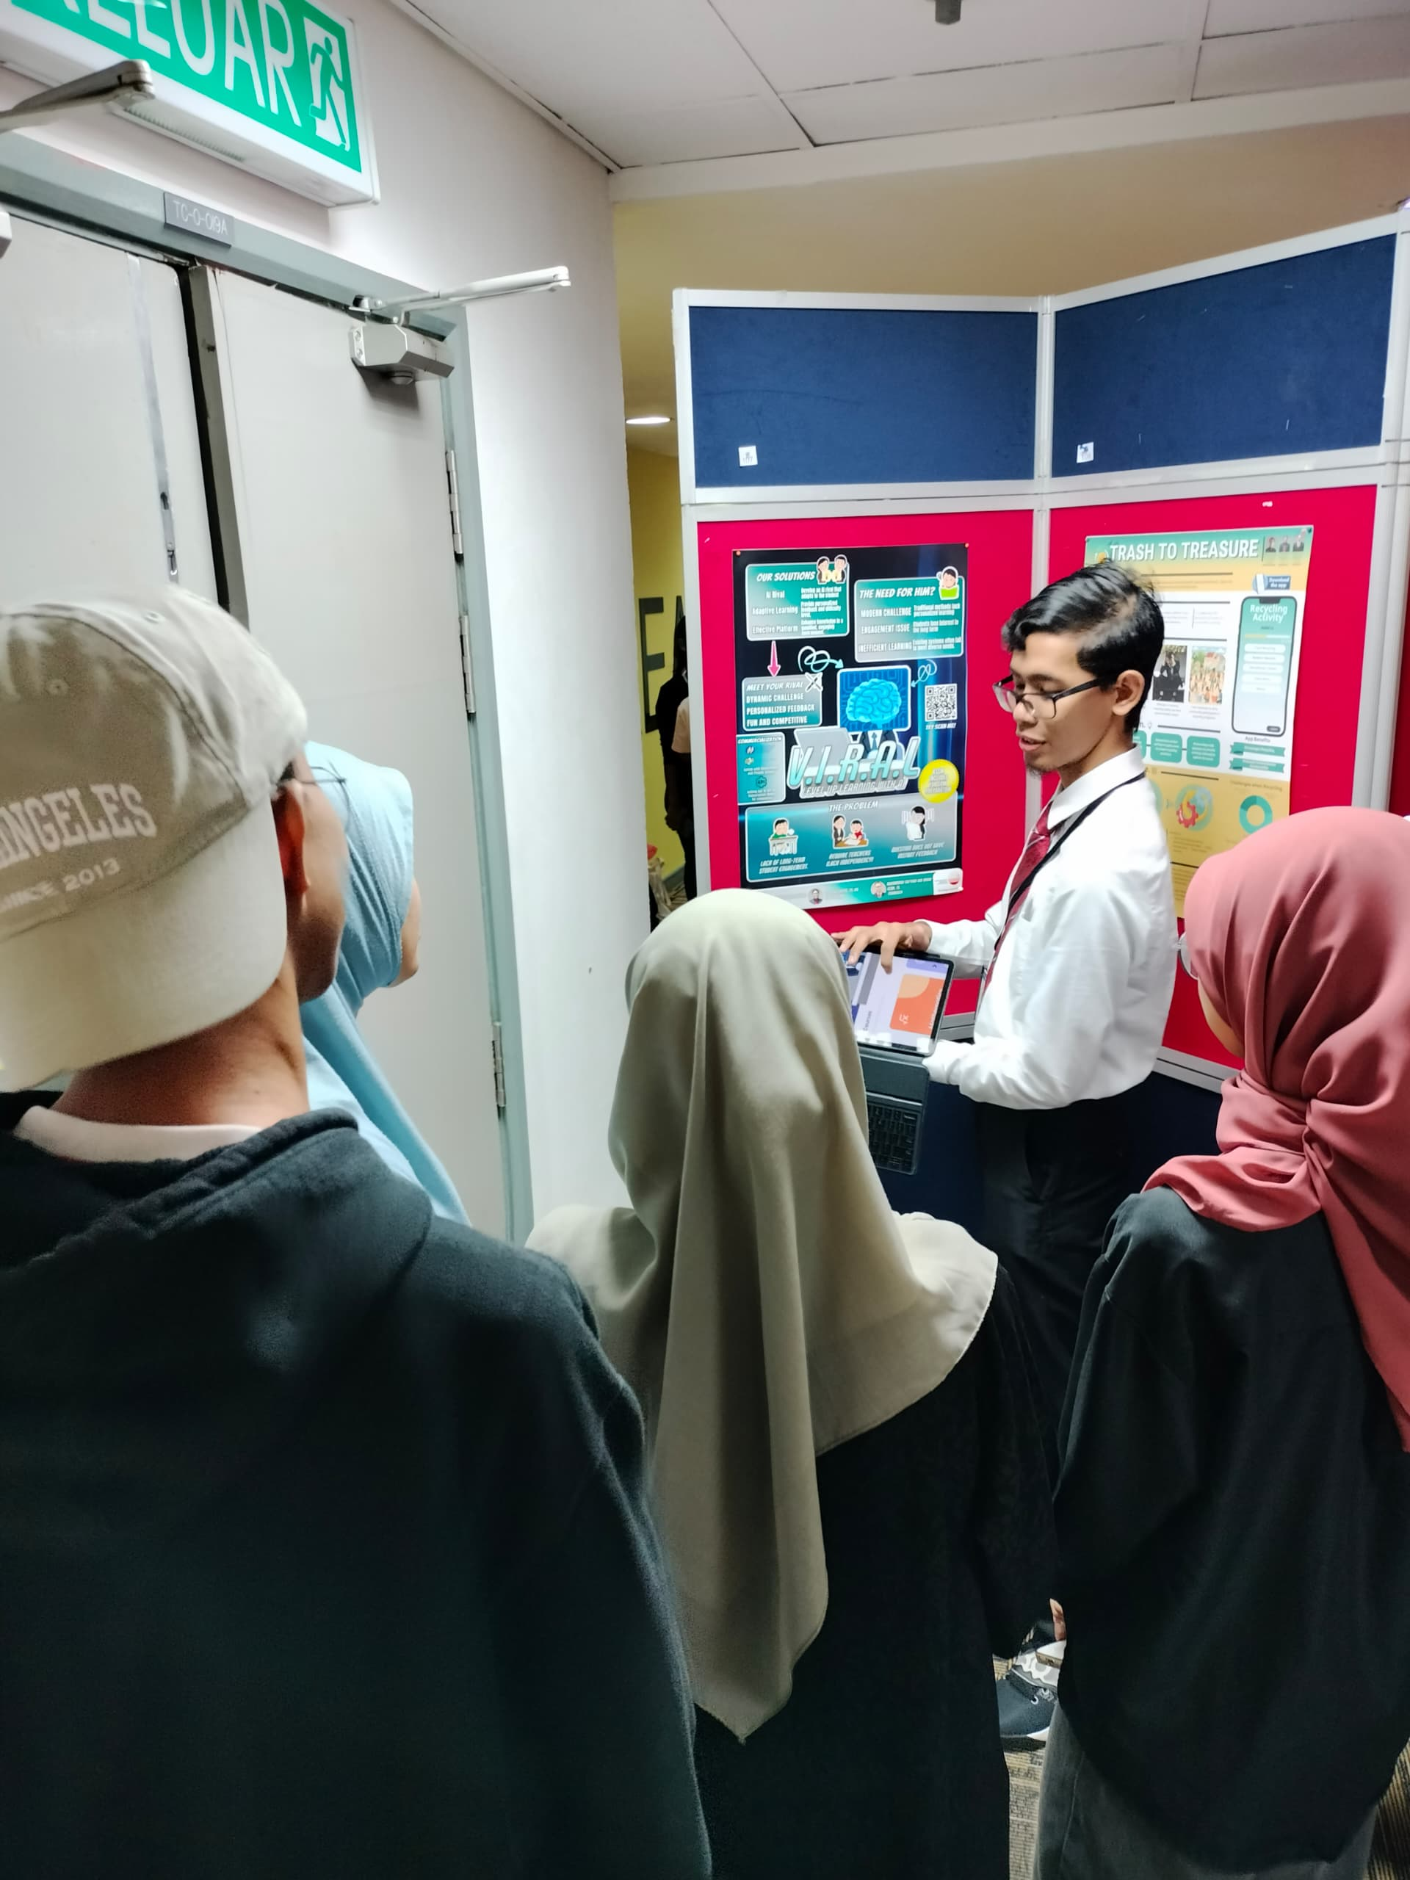
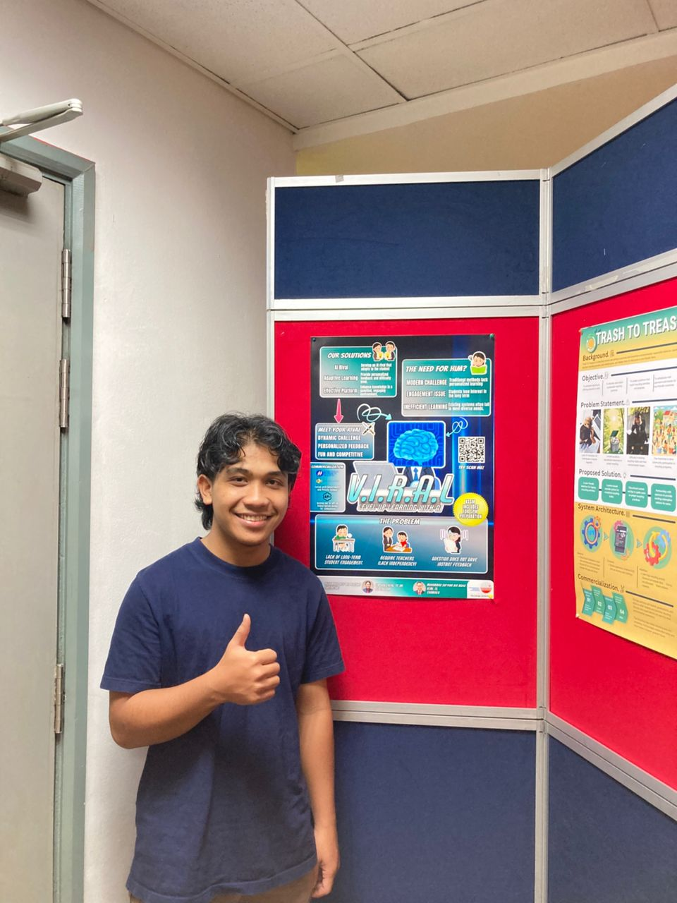
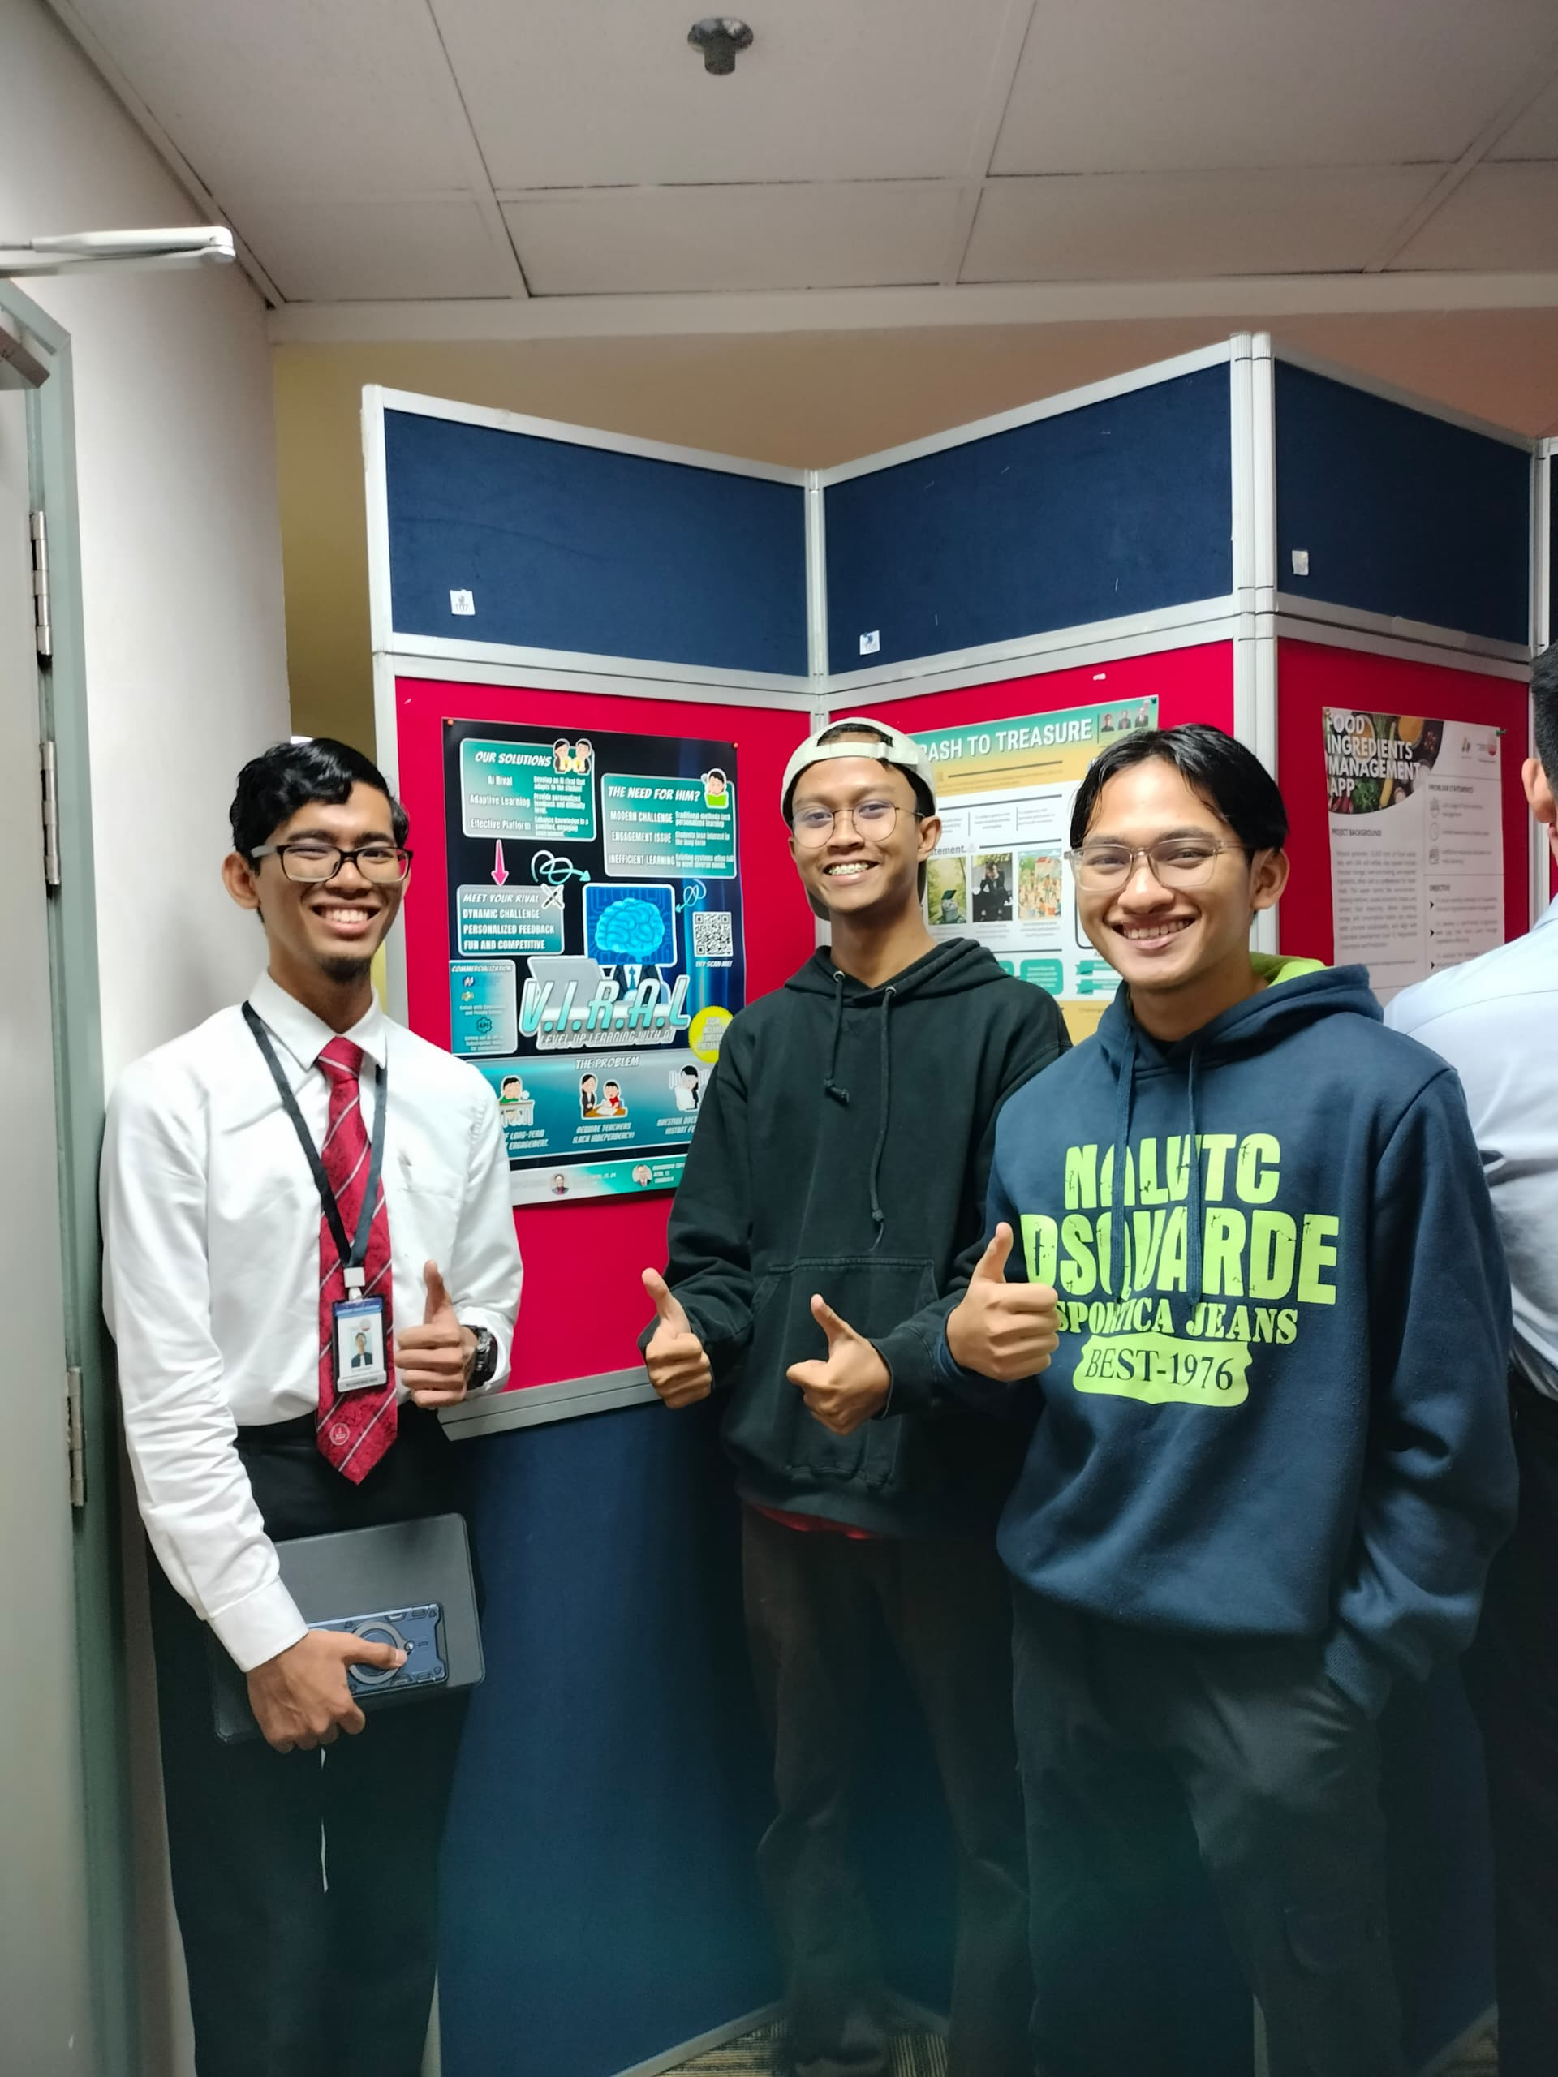
Summary of 5 Best Final Year Project 1
2. Virtual Integrated Rival AI Learning (VIRAL)
Project Name : V.I.R.A.L (Level Up Learning with AI)
Presented By :Muhammad Asif Bin Aidwan
Supervisor : Lim Kok Cheng
Summary of the project : V.I.R.A.L. is an AI-powered educational platform that improves learning outcomes through individualized challenges, feedback, and gamified experiences. It has an adaptive AI competitor to increase participation and solve traditional learning’s inefficiencies
Reason for Choosing : V.I.R.A.L. support SPM preparation and encourages individualized, self-directed learning while working with educational institutions and governmental organization to have a significant effect.

Slide 23
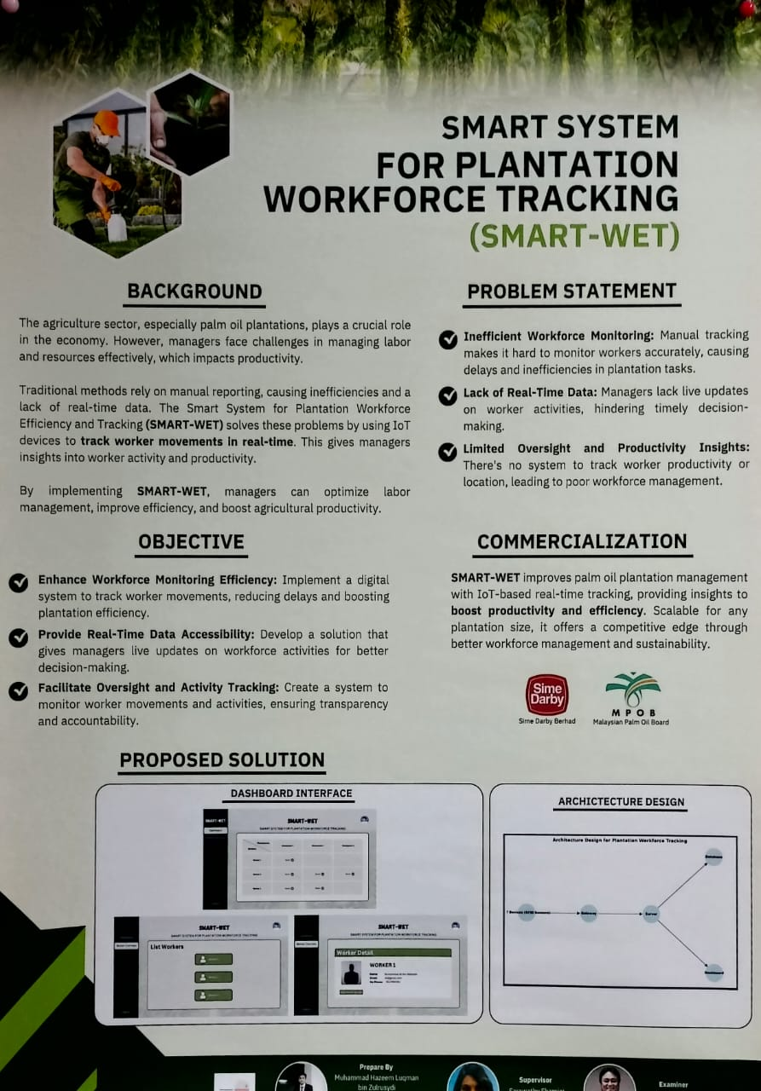
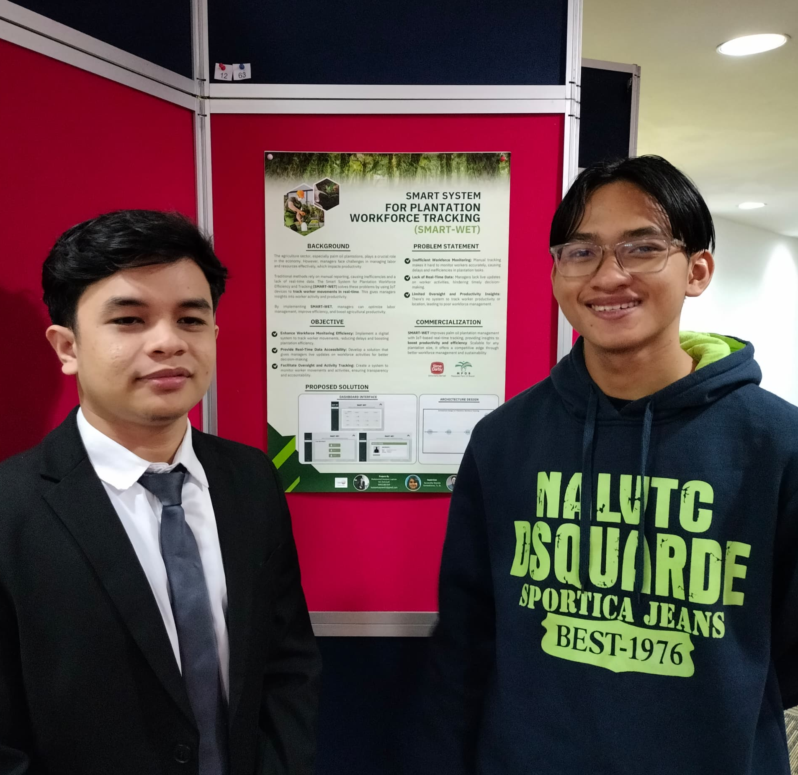
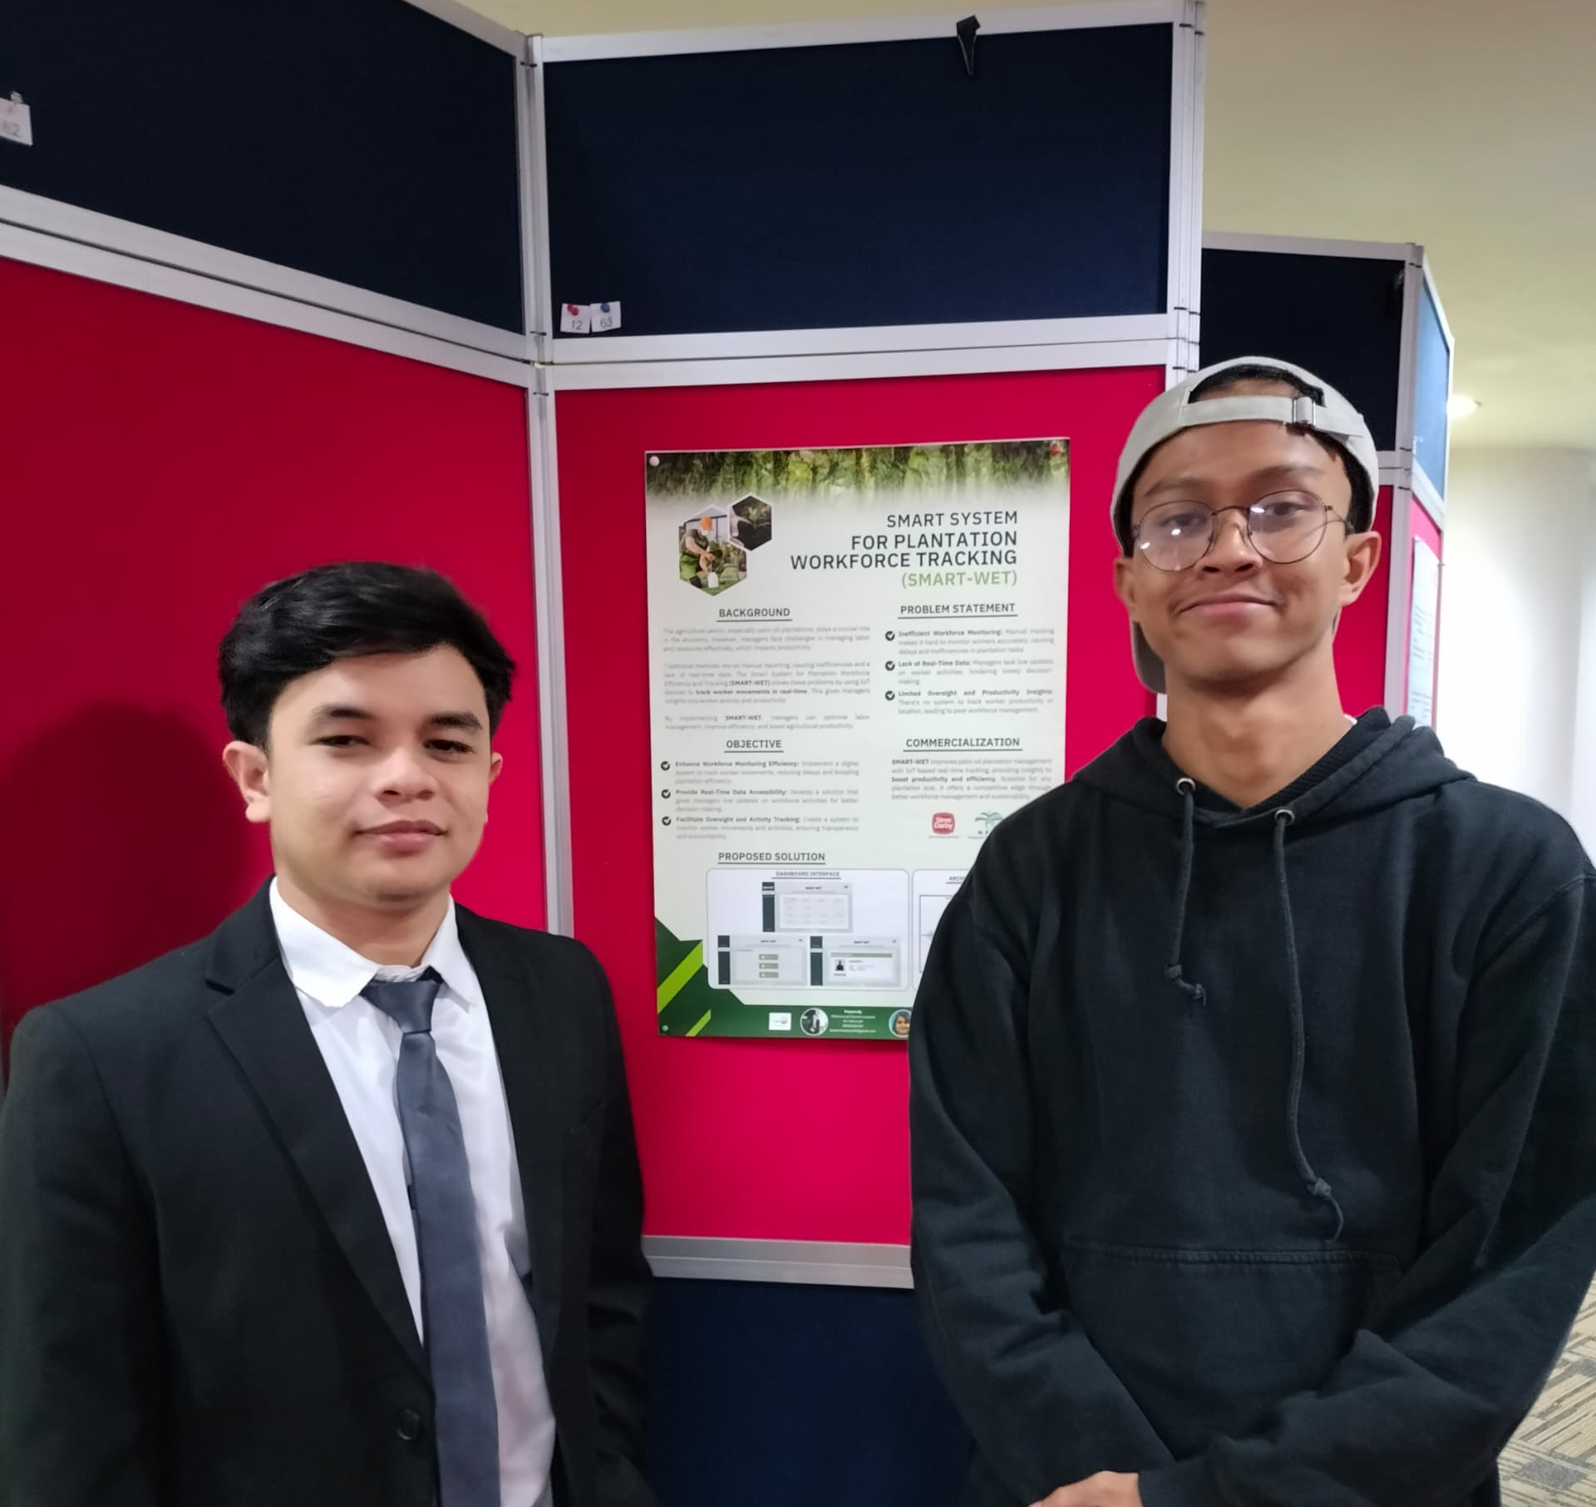
Summary of 5 Best Final Year Project 1
3. Smart System for Plantation Workforce Tracking (SMART-WET)
Project Name : SMART-WET
Presented By : Muhammad Hazeem Luqman
Summary of the project : SMART-WET uses IoT technology to track the movement of plantation workers in real time. By resolving the inefficiencies of conventional manual monitoring, offering real-time updates, and facilitating improved supervision and efficiency via a digital dashboard interface.
Reason for Choosing : SMART-WET solved major issues in plantation worker management by providing a real-time tracking system. IT is a useful instrument for updating agricultural methods because of its capacity to increase production, and facilitate well-informed decision-making.

Slide 24
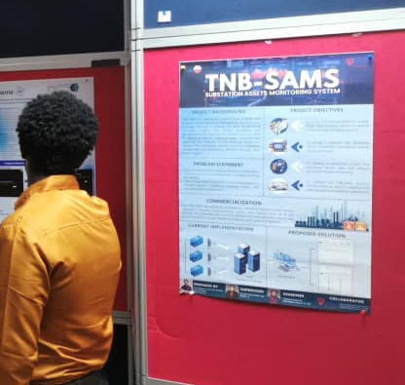
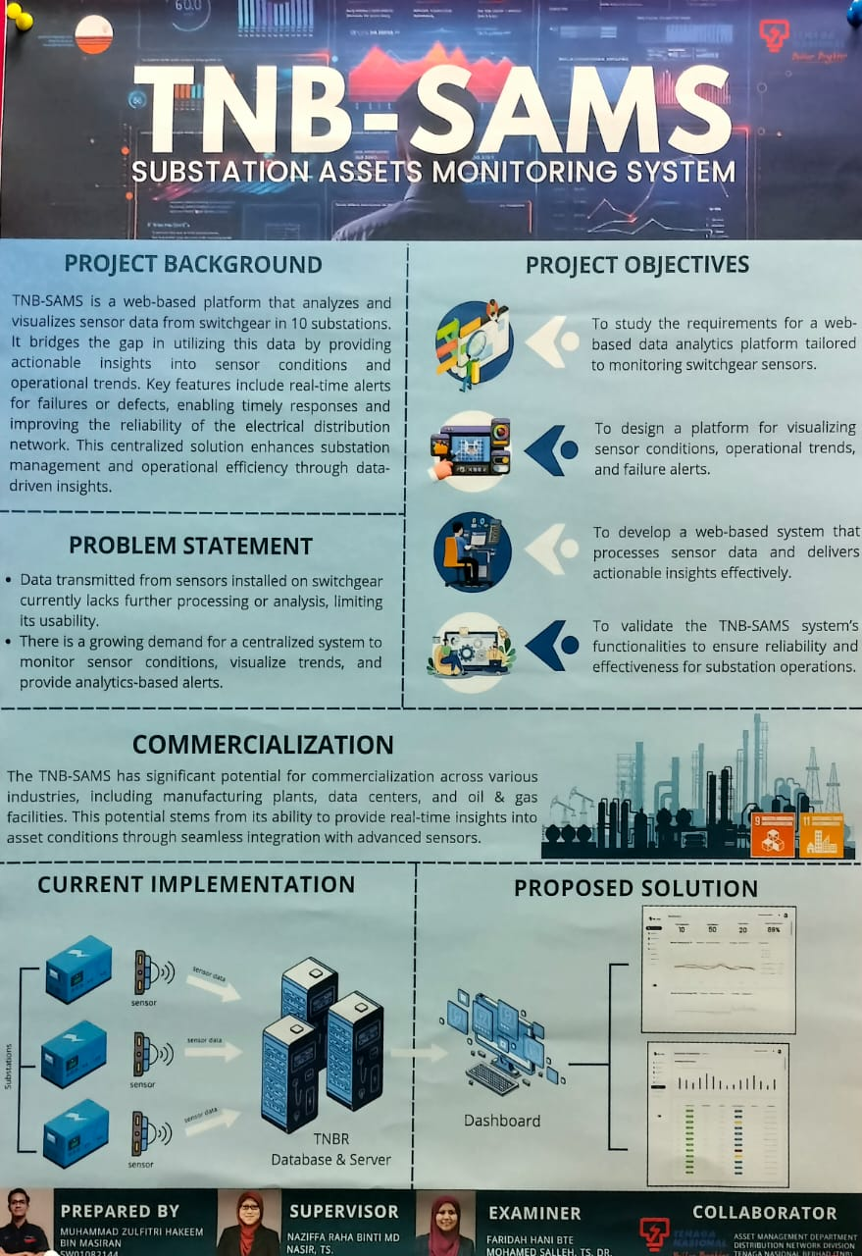
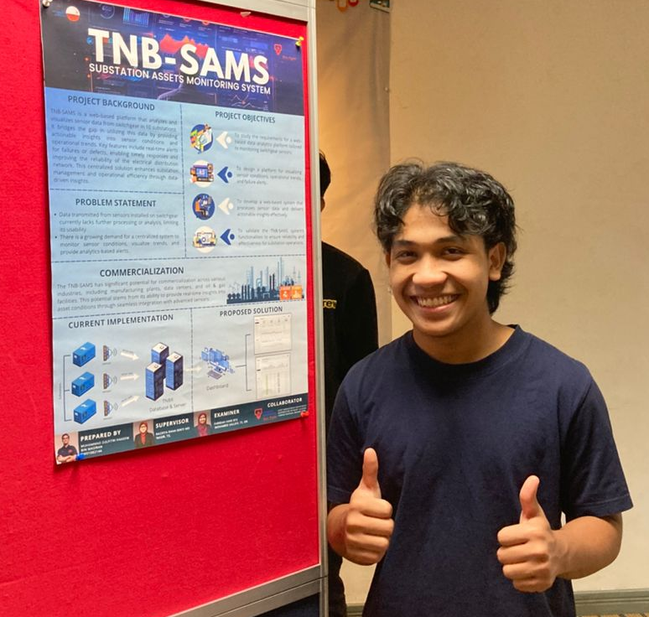
Summary of 5 Best Final Year Project 1
4. TNB-Substation Assets Monitoring System (SAMS)
Project Name : TNB-SAMS
Presented By : Muhammad Zulfitri Hakeem
Supervisor : Naziffa Raha Binti Md Nasir, TS.
Summary of the project : TNB-SAMS is an online tool that evaluates and display data from switchgear sensors, offering real-time notifications and practical advice to improve the dependability and operational effectiveness of electrical distribution
Reason for choosing : TNB-SAMS improves asset management and operational performance by meeting the demand for centralized sensor monitoring. It is useful in a variety of sectors, including manufacturing, data center, and the oil and gas industry, due to its versatility

Slide 25
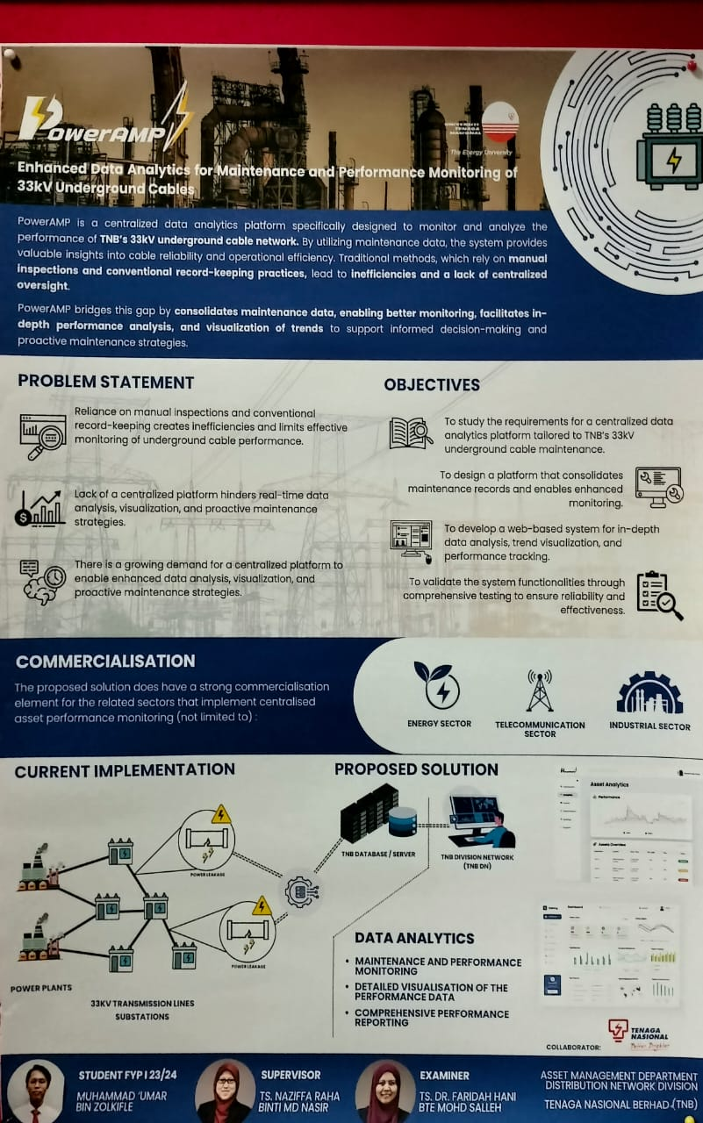
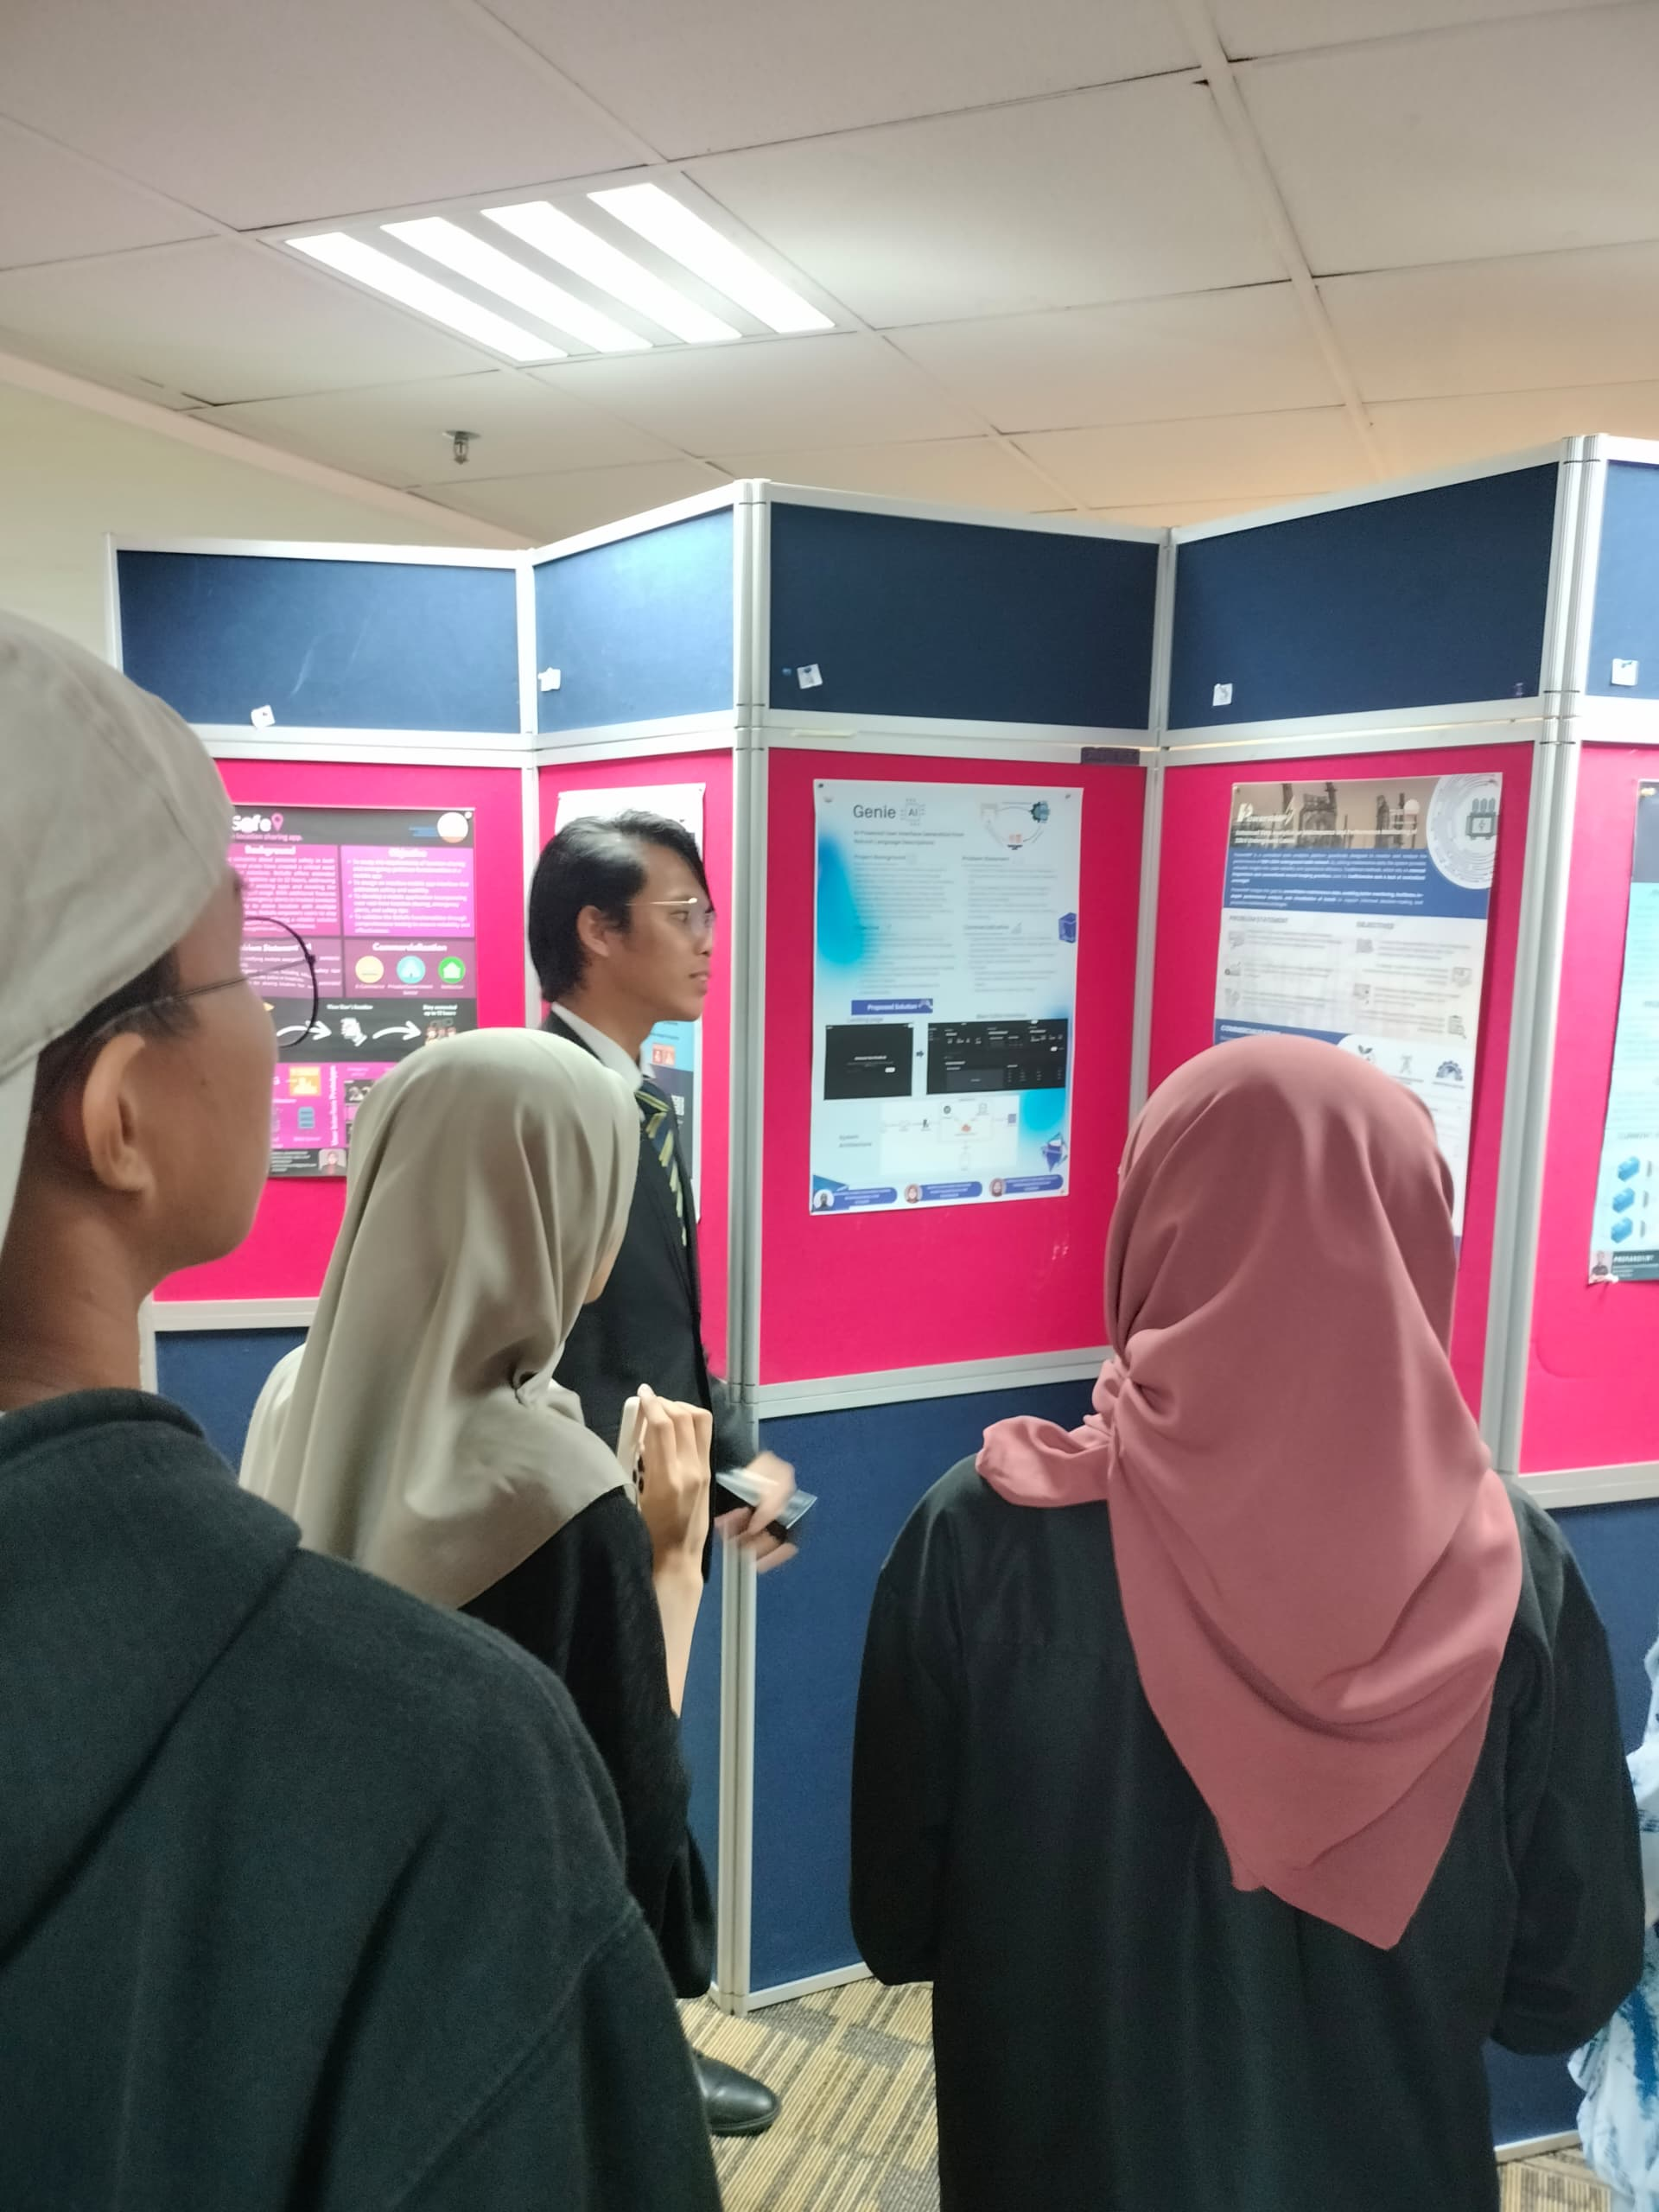
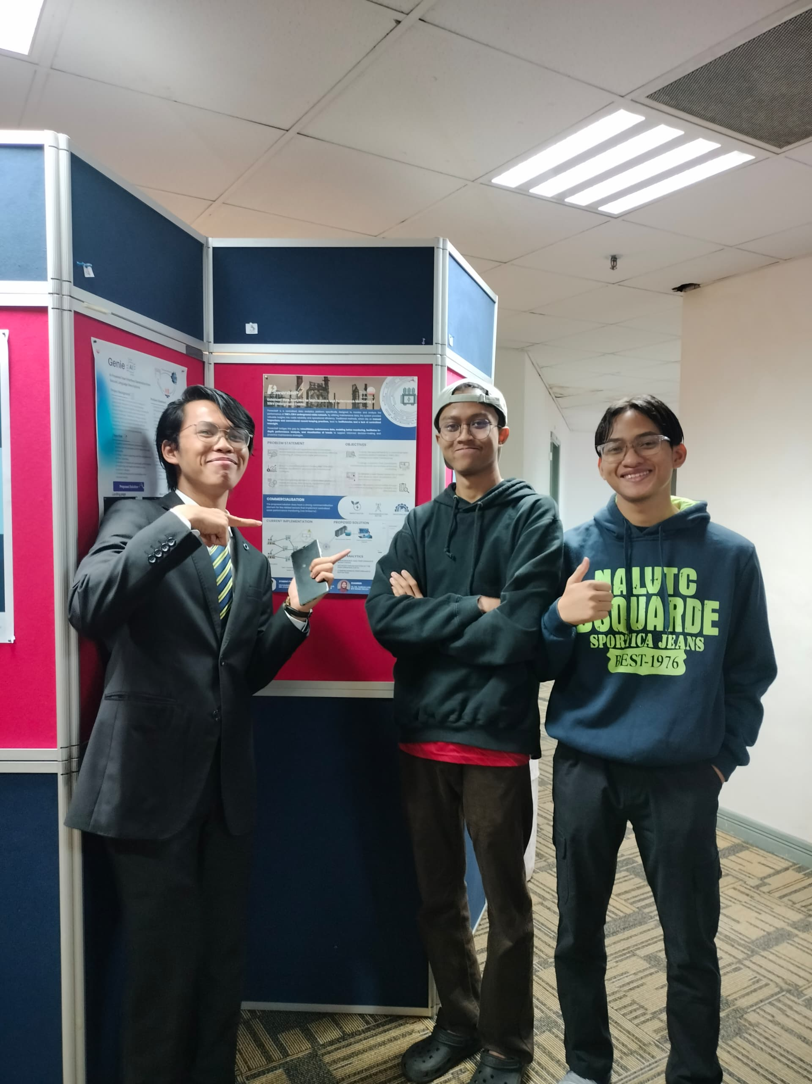
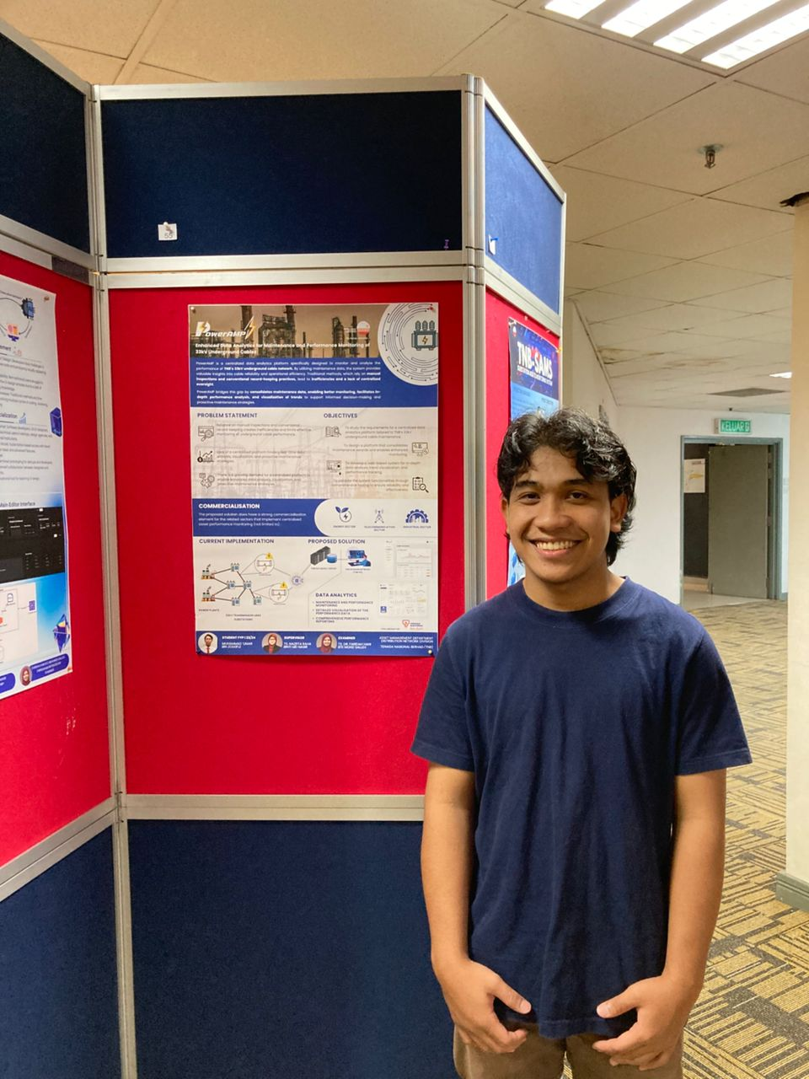
Summary of 5 Best Final Year Project 1
5. PowerAMP
Project Name : PowerAMP
Presented By : Muhammad Umar bin Zolkiflie
Supervisor :TS. Naziffa Raha binti MD Nasir
Summary of the project : PowerAMP is a centralized platform that monitor and analyzes TNB’s 33kV underground cable network. Through the consolidation of maintenance data, proactive maintenance, performance analysis, and improved monitoring are made possible.
Reason for Choosing : Data analysis and manual cable monitoring inefficiencies are solved with PowerAMP. Its adaptability support well-informed decision-making and optimal maintenance in the energy, telecommunications, and industrial sectors.

